Slide 1

Hotel Reservation Analysis
Project Number:01
Name: Shashank N Shetty
Batch: MIP-DA-04

Slide 2
Introduction
The given Dataset is about Hotel Reservation Analysis.
The hotel industry relies on data to make informed decisions and provide a better guest experience.
This dataset majorly consist of 12 columns and 700 records or datapoints.
Features:
Booking_ID: A unique identifier for each hotel reservation.
no_of_adults: The number of adults in the reservation.
no_of_children: The number of children in the reservation.
no_of_weekend_nights: The number of nights in the reservation that fall on weekends.
no_of_week_nights: The number of nights in the reservation that fall on weekdays.
type_of_meal_plan: The meal plan chosen by the guests.

Slide 3
Features
room_type_reserved: The type of room reserved by the guests.
lead_time: The number of days between booking and arrival.
arrival_date: The date of arrival.
market_segment_type: The market segment to which the reservation belongs.
avg_price_per_room: The average price per room in the reservation.
booking_status: The status of the booking.

Slide 4
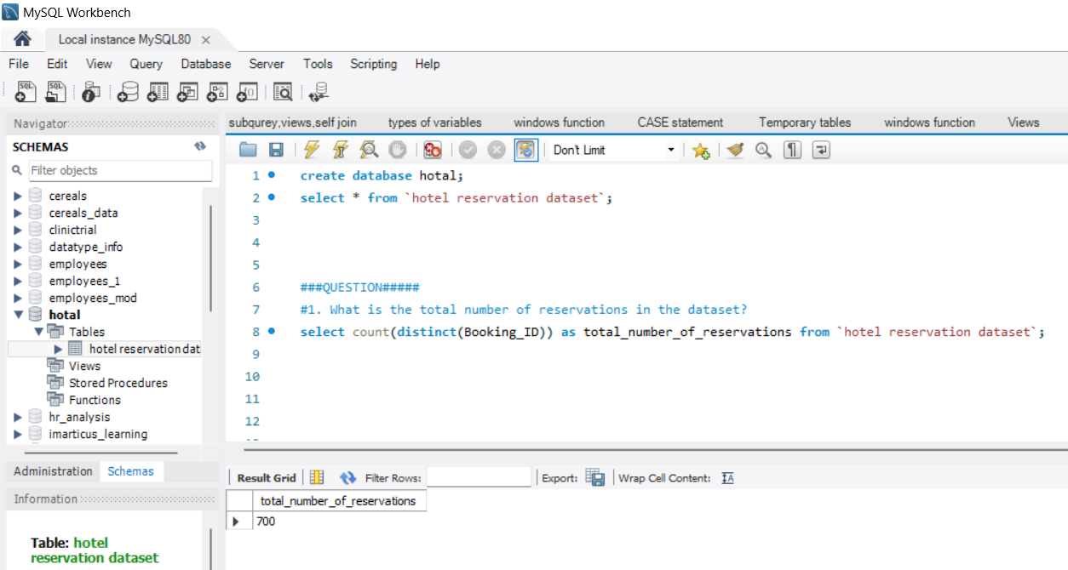
What is the total number of reservations in the dataset?
By seeing the result we will clearly come to know that the total number of reservations is 700.

Slide 5
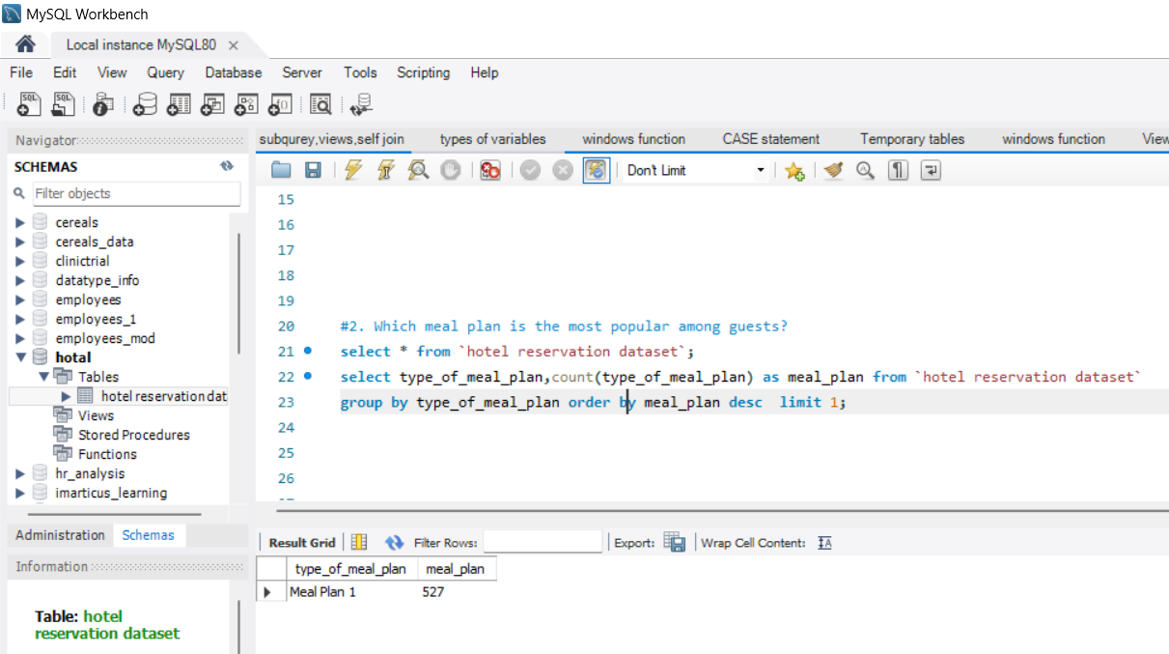
Which meal plan is the most popular among guests?
By seeing the result we will clearly come to know that most popular meal plan is Meal Plan 1

Slide 6
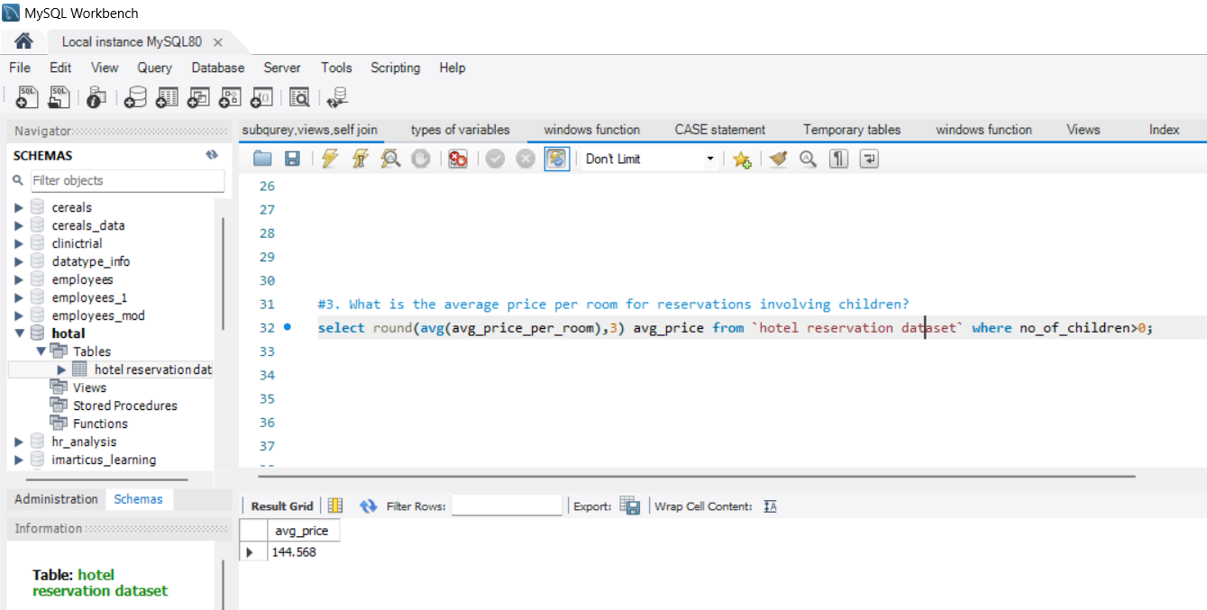
What is the average price per room for reservations involving children?
By seeing the result we will clearly come to know that average price per room for reservations with children is 144.568

Slide 7
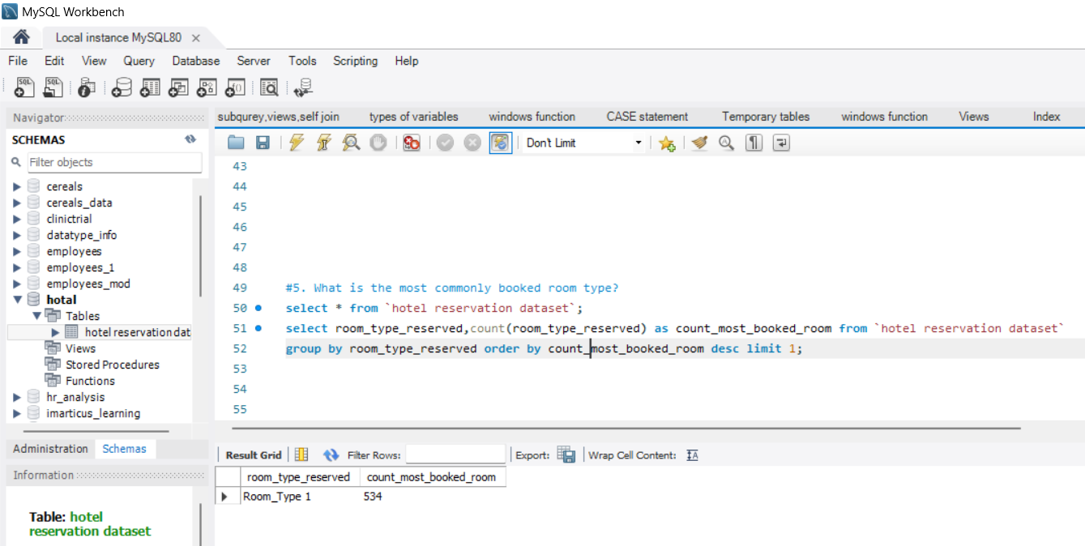
What is the most commonly booked room type?
By seeing the result we will clearly come to know that the most commonly booked room type is Room_Type1

Slide 8
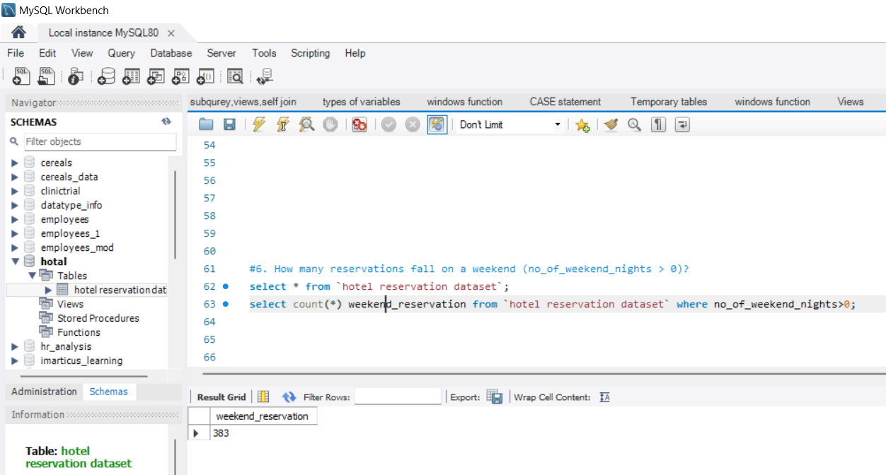
How many reservations fall on a weekend (no_of_weekend_nights > 0)?
By seeing the result we will clearly come to know that the reservations fall on a weekend is 383

Slide 9
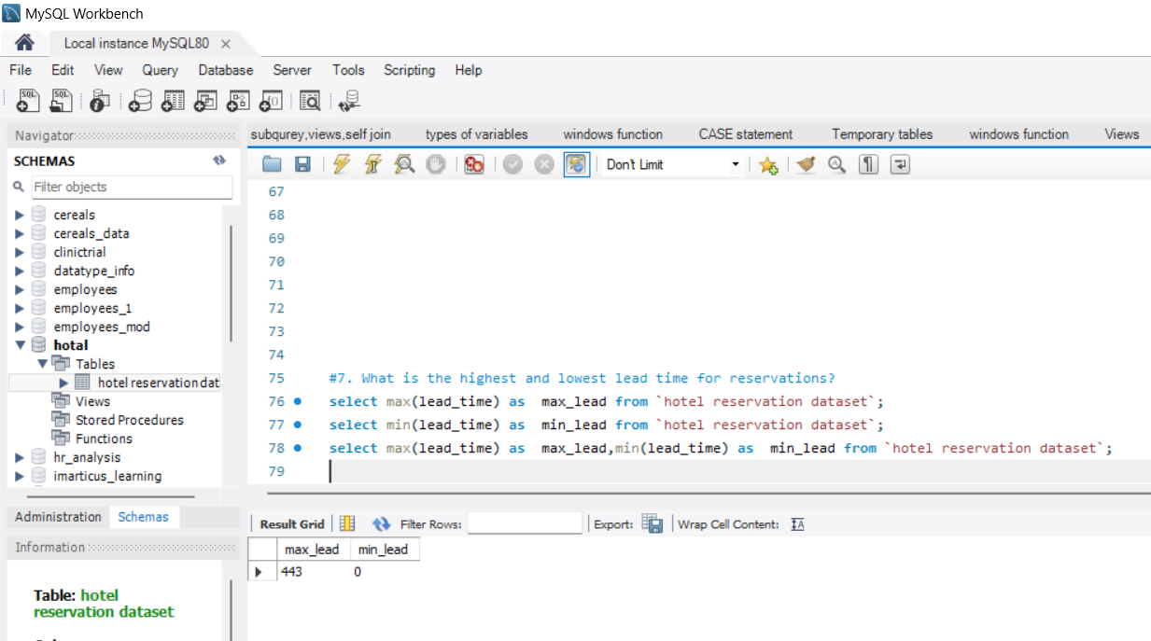
What is the highest and lowest lead time for reservations?
By seeing the result we will clearly come to know that the highest and lowest lead time is 443 & 0

Slide 10
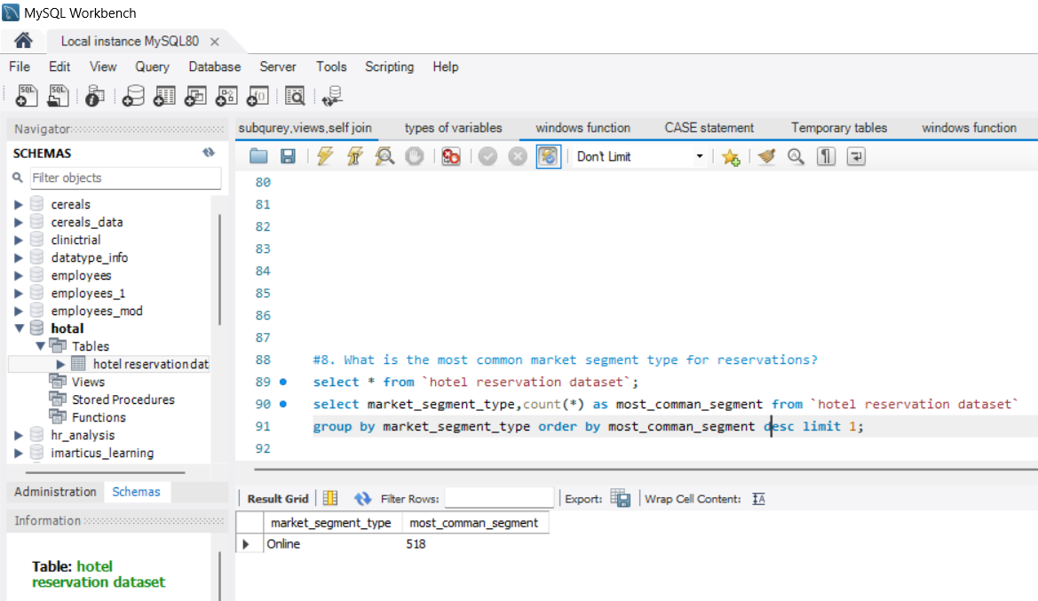
What is the most common market segment type for reservations?
By seeing the result we will clearly come to know that the most common market segment type is Online

Slide 11
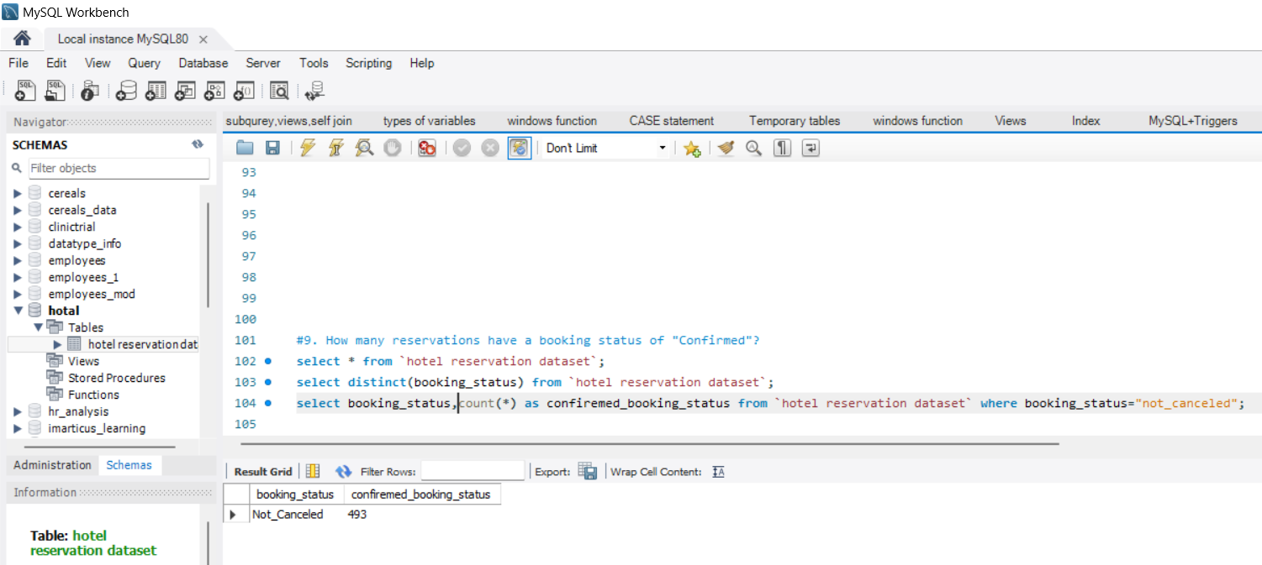
How many reservations have a booking status of "Confirmed"?
By seeing the result we will clearly come to know that the confirmed booking status is 493

Slide 12
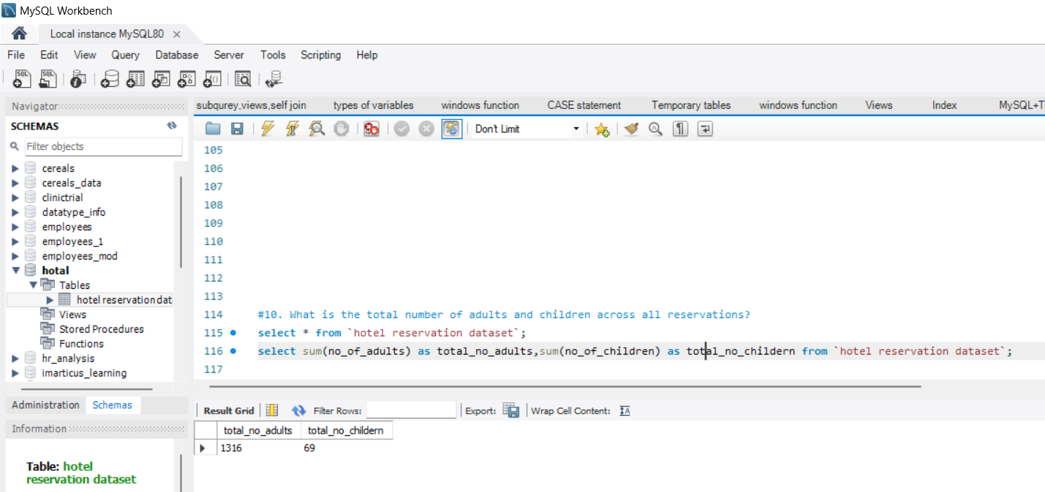
What is the total number of adults and children across all reservations?
By seeing the result we will clearly come to know that the total number of adults and children is 1316 & 69

Slide 13
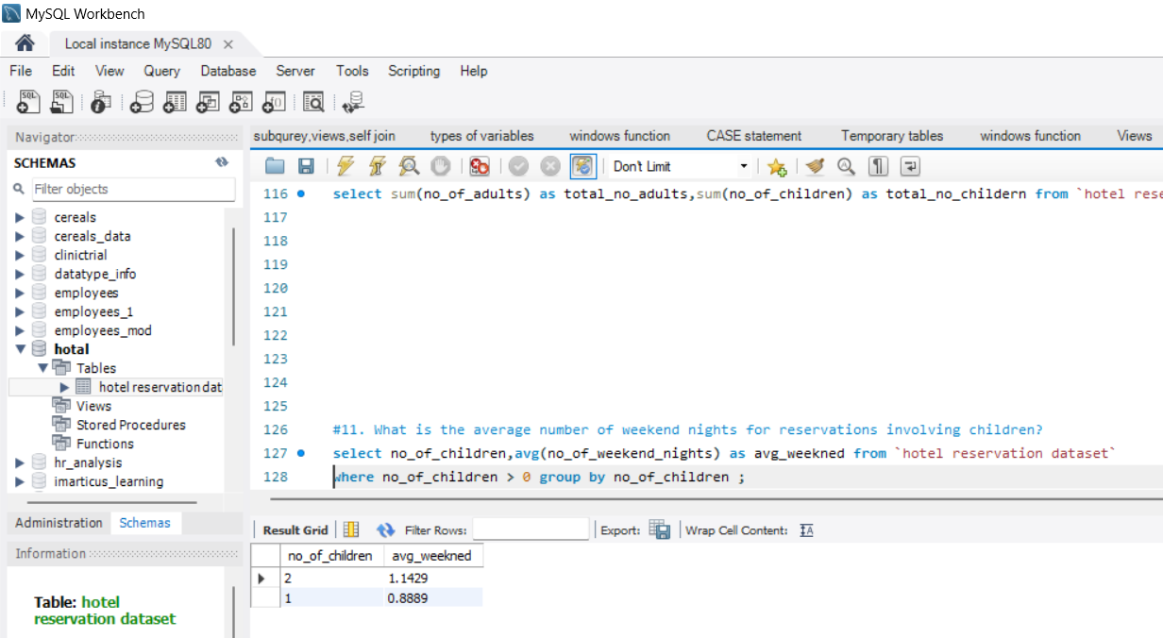
What is the average number of weekend nights for reservations involving children?
By seeing the result we will clearly come to know that the average number of weekend nights for 1 children the avg is 1.1429 and 2 children the avg is 0.8889

Slide 14
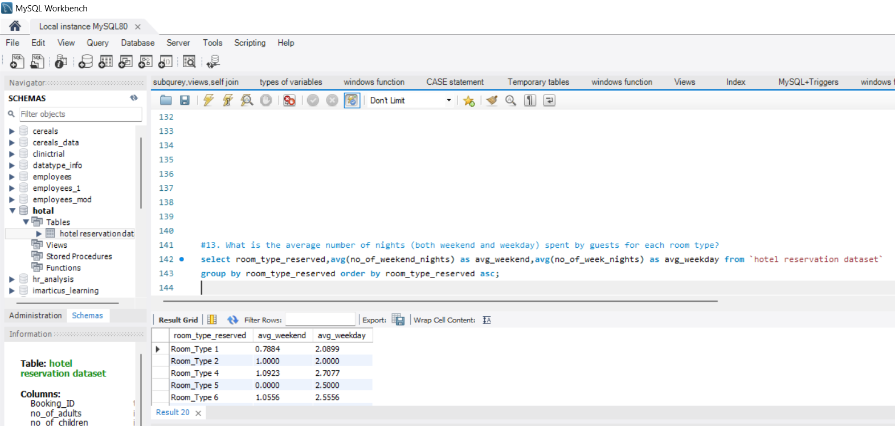
What is the average number of nights (both weekend and weekday) spent by guests for each room type?
By seeing the result we will clearly come to know that

Slide 15
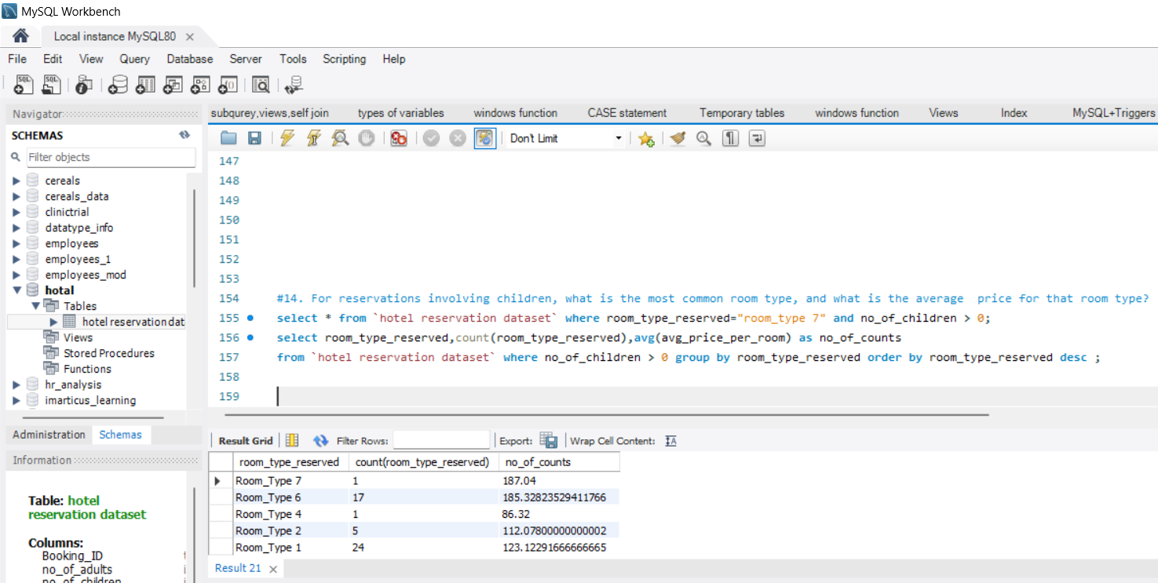
For reservations involving children, what is the most common room type, and what is the average price for that room type?
By seeing the result we will clearly come to know that

Slide 16
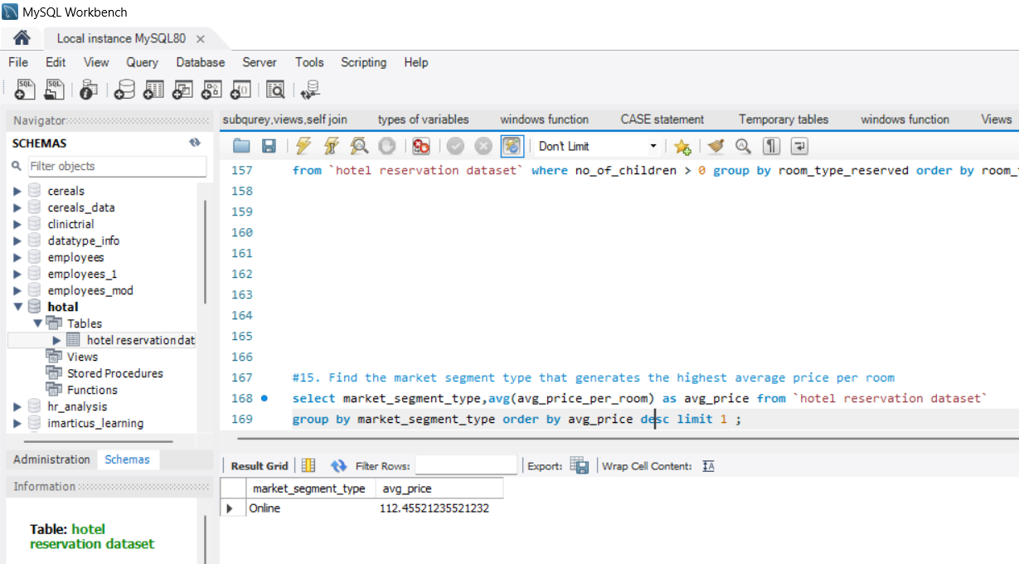
Find the market segment type that generates the highest average price per room.
By seeing the result we will clearly come to know that Online market segment type generates the highest average price per room

Slide 17
Thank You

